Slide 1
Credit Scoring
SivaYogitha Mokkapati
Ramya Muthukrishnan
IE-575 –Predictive Analytics (Spring I, 2020)

Slide 2
Agenda
Introduction
Problem Statement
What’s our approach
Methodology
Demo
Results
Q&A

Slide 3
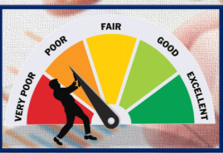
Introduction
What is Credit Scoring
Why is it important
Challenges involved

Slide 4
Problem Statement
Model the Australian dataset and predict whether a customer is good or bad
Link to the dataset
UCI Machine Learning Repository
Why we chose Australian dataset

Slide 5
Approach
Demonstrate the modeling techniques learnt in class.
Compare the metrics.
Conclude which technique works well for this dataset.

Slide 6
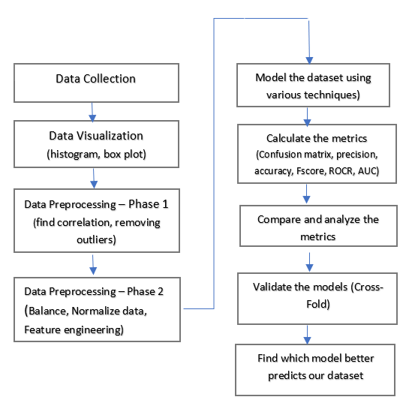
Methodology

Slide 7
Models used
Logistic Regression
Naive Bayes
SVM
CART
C5.0
Neural Network
Random Forest
Bagging on CART
Boosting on CART
Notes:
These are the commonly used models for binary classification

Slide 8
Demo time !

Slide 9
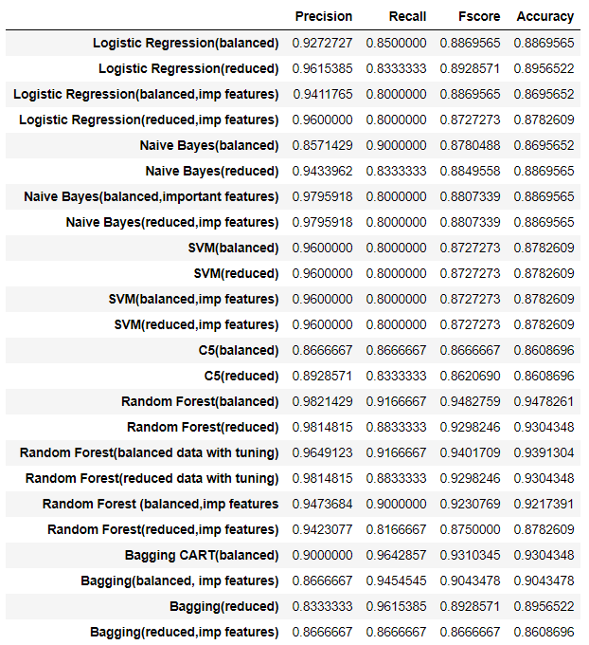
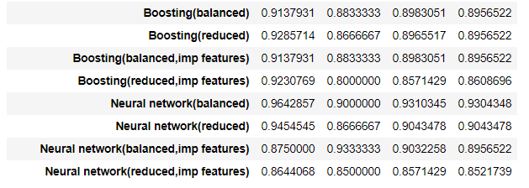
Results
It is better to consider only few important features that to consider the entire dataset as most of the performance metrics is almost the same considering only few features. There is no need to consider 14 features when we can get almost the same performance metrics with only 4 or 5 features.

Slide 10
Features impacting performance
Features contributing more towards accuracy of each model are listed below:
Logistic Regression V4, V5, V8 and V13
Naïve Bayes V4, V5, V8, V13
SVM V4, V5, V8 and V13
CART V5, V8, V10, V12, V13
C5 V5, V8, V10, V12, V13
Random Forest V5, V7, V8, V10, V14
Bagging V5, V8, V10, V12, V13
Boosting V5, V8, V10, V12, V13, V14

Slide 11
Lessons Learnt
Adding relevant features to train your model can boost the model performance significantly (features engineering).
Don’t celebrate after preprocessing data. There is always scope to clean the data before modelling.

Slide 12
References
Academic - All the in class activities and code uploaded in the canvas
R documentation of the packages
PCA Tutorial - https://www.dezyre.com/data-science-in-python-tutorial/principal-component-analysis-tutorial
Credit Scoring using Weighted Voting and Clustering
Novel Credit Scoring Prediction Model

Slide 13

Q&A

